Slide 1
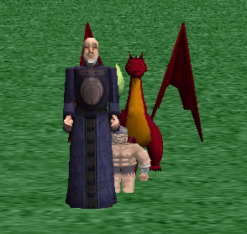
Camera Control: Learning to Use the Camera in Alice
By Henry Qin, edited by Jenna Hayes
under the direction of Professor Susan Rodger
Duke University, August 2008

Slide 2
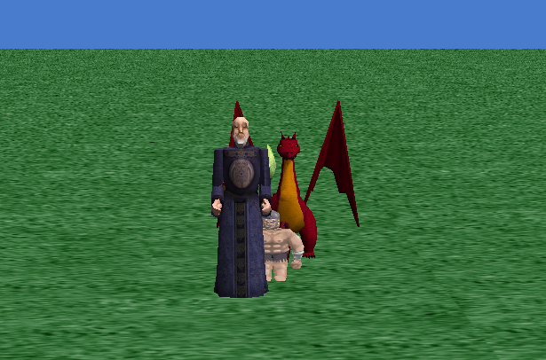
Camera Controls
This tutorial will go through different ways of using the camera in Alice, such as changing and saving camera positions. Download and open the starting world that goes with this tutorial, and we will get started.
These characters will be in the downloaded world.

Slide 3
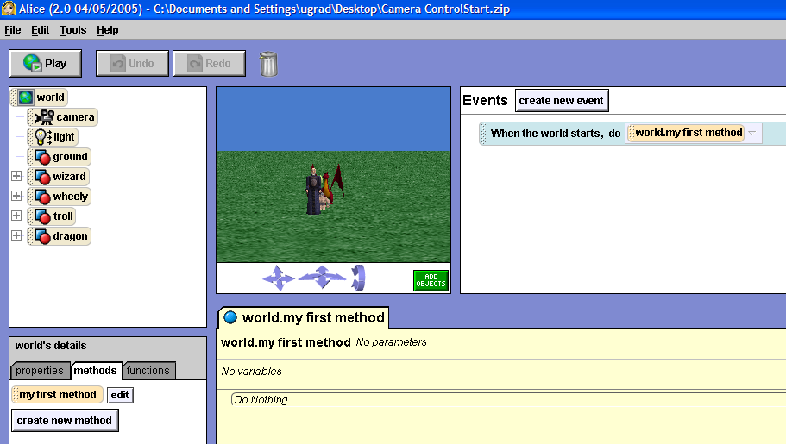
Going to the “Add Objects” Screen
First, click on the green add objects button in the upper left area of your screen. This will bring us to the add objects screen, where certain things can be done to the camera.

Slide 4
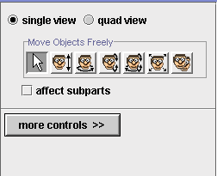
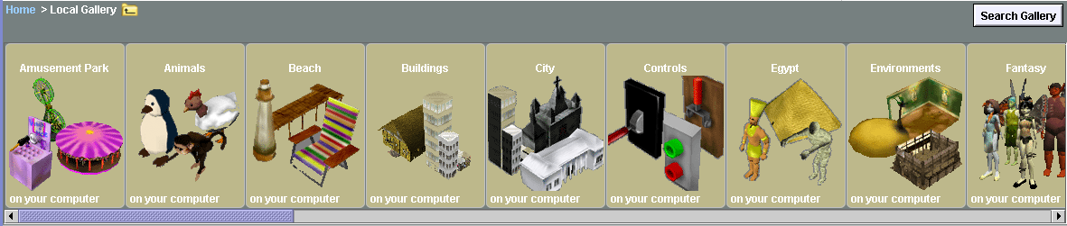
The “Add Objects” Screen
This is the add objects screen. There are buttons that are used to move objects in different ways on the right-hand side, and at the bottom you can see folders that contain all of the possible objects you can add to an Alice world.
Object-controlling
buttons
Folders of objects

Slide 5
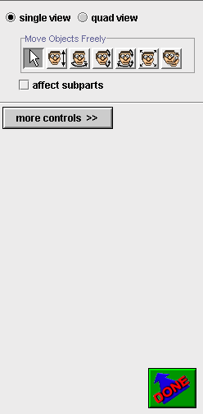
Saving a Camera Position
To save a camera position in Alice, you use something called a dummy object, which is just an invisible object that is placed at your camera's exact position, and stays there even if you move your camera around. To drop a dummy object, first click on the more controls button on the right hand side of your screen, under the object-controlling buttons.

Slide 6
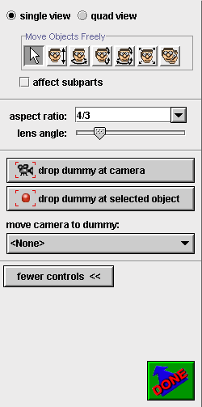
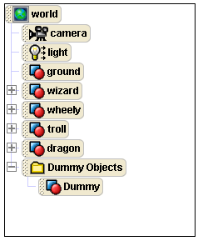
Saving a Camera Position
More controls should appear on the screen. Click the drop dummy at camera button.
This will make a new folder appear on your object tree, called Dummy Objects. Click on the plus sign next to the folder to see your new object, named Dummy.

Slide 7
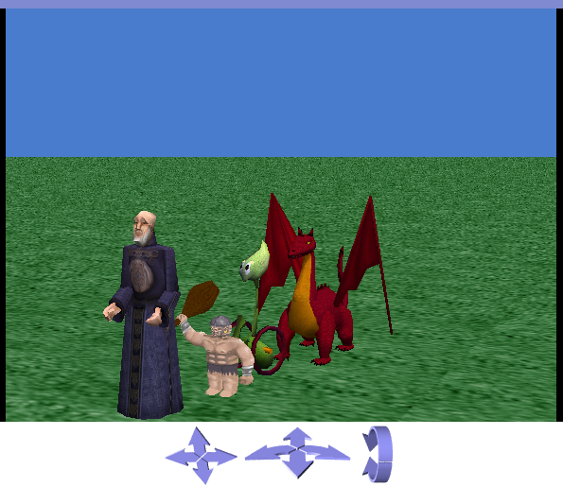
Using the Dummy Object
Now try moving your camera to a different position using the blue arrows under the viewing screen. We will then show you how to get your camera back to its original position.
Use these arrows to move your camera to a new position, such as this.

Slide 8
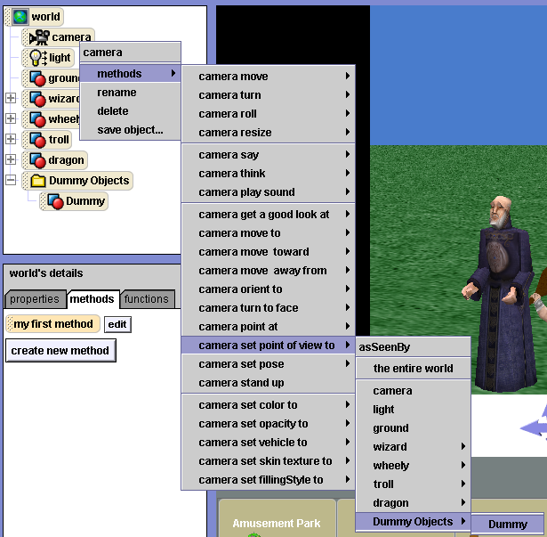
Using the Dummy Object
There are two ways to put the camera back to its original position. The first way is to right click on camera in the object tree, and then select methods, then set point of view to, then dummy objects, then dummy.

Slide 9
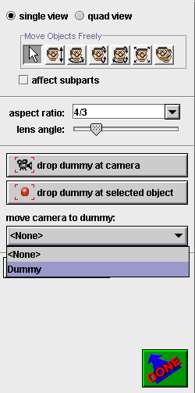
Using the Dummy Object
The second way to re-set the camera is to simply click on the move camera to dummy button on the right-hand side of the screen, and then select dummy. However, this is only available if you are on the add objects screen.

Slide 10
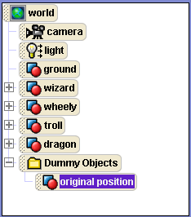
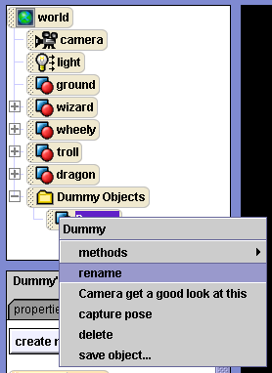
Renaming Your Dummy
Whenever you create a dummy object in Alice, it is automatically named Dummy. To remember which position each dummy holds, you should re-name them to something more meaningful. Right click on Dummy in your object tree and select rename to do this. We'll rename ours original position.

Slide 11
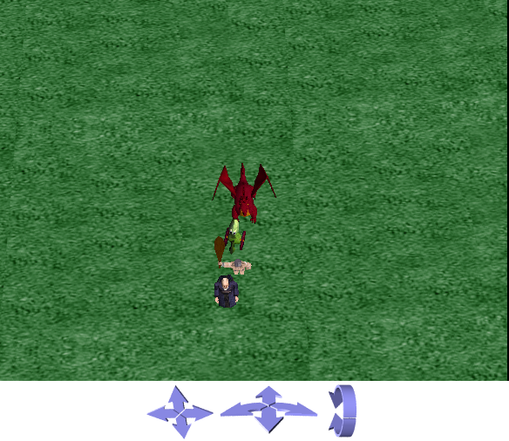
Using the Blue Arrows
Now we want to use these arrows to get an overhead view of our four characters, so we can place them in a diamond shape. Try to get your camera
view to look like this:
Use this up arrow to get your camera high in the sky.
Use this forward arrow to tilt your camera down towards the characters.
Use this forward arrow to position your camera over the characters.

Slide 12
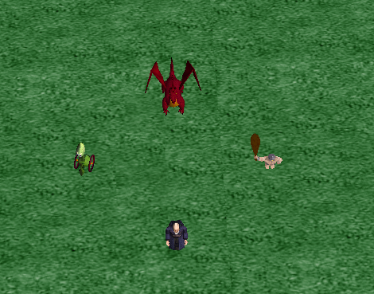
Positioning the Characters
First, drop a dummy object at your camera. Name it something like overhead view. Then, using your object positioning buttons, arrange your characters in the shape of a diamond, like this:

Slide 13
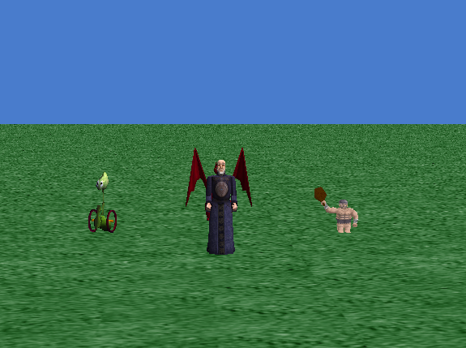
Finishing Up
Now set your camera back to original position to check out what your characters look like from the front. Use the techniques you have learned in this tutorial to position objects and save camera positions in your future Alice worlds!

